Slide 1
A GPS and Machine Learning Driven Approach to Pothole Detection and Reporting System
KKR & KSR INSTITUTE OF TECHNOLOGY AND SCIENCES
Team members :
K.Deepthi(20JR1A0566) GuideName:MRS.S.VIJAYALAKSHMI
M.Lakshmi Tripura(20JR1A0584) Associate Professor
K.Shivani(20JR1A0567)
L.SIVANI(20JR1A0580)

Slide 2
ABSTRACT
The number of vehicles that are on the road today, whether it is highways or single carriageways, is increasing all the time.system is crucial to ensuring long-term vehicle safety.
In addition to preventing accidents due to potholes, landslides, and uneven roads, a road structure safety monitoring system is crucial to ensuring long-term vehicle safety.
Reporting potholes to road maintenance authorities is therefore crucial to facilitating their continuous maintenance and repair.
To overcome this problem, in this project, focuses on the development of a Machine -learning-based pothole detection and reporting system, to assist road maintenance personnel in making informed road repair decision.
custom dataset comprising pothole photos obtained from online sources is used to create and train a CNN model.

Slide 3
Abstract
The model is included into the entire system to make it easier to identify potholes in uploaded photos.
The locations of potholes that have been found are added to maps in comprehensive data visualizations.
There are plenty of pothole identification models that combine machine learning and accelerometer data with Machine Learning .
However, there are fewer models available for detecting potholes that rely only on machine learning Methods.
The proposed method uses Machine learning algorithms may offer precise and effective pothole Identification solutions , which can aid in road maintenance and repair, lessen car damage , and improve road safety.

Slide 4
Introduction
After the US, automobile usage is the second largest form of transportation globally in India.
The Indian government contributes millions of rupees annually to the construction
and maintaining of roads, which is an important cost in the national budget.
A nation's infrastructure advancements determine its level of economic success and growth.
Infrastructure development has a number of obstacles, yet a well-functioning network
is important for business, social mobility, industry, and national communication.
The highway infrastructure should be maintained, and the damages may be the reason for
the growing amount of accidents.
However, roads inside towns are constructed to be smaller and made up of one or two lanes.

Slide 5
Introduction
▶ Roads are vital in people’s daily life, so periodic maintenance shall
be made to keep them functional and safe.
▶ The vast majority of the nation's roadways have congestion,
have poor surfaces, and have unsatisfied maintenance demands.
▶ Roads have many undesired potholes that are extremely unsafe
for commuters due to inadequate road network design
and development as well as natural calamities like severe rains.
▶ On a daily basis, commuters have to struggle with problems because of
awful road conditions.
▶ Because of the discomfort, stress, and frustration that traffic
congestion affects for everyone, it is crucial to increase awareness
of these dangerous driving circumstances.

Slide 6
Introduction
▶ Potholes additionally result in an enormous amount of injury to automobiles.
▶ Typical problems involve damage to the suspension, steering, tires and rims,
and even the body of the automobile.
▶ Additionally, potholes may cause vehicles to become out of alignment, which
may lead to uneven tire wear and an earlier need for replacement.
▶ This imposes a significant financial strain on the country's residents. According to
the Ministry of Road Transport and Highways, approximately 11300 people died
and 29600 were injured in road accidents caused by potholes in 2021, 2022, and 2023.
▶ According to UNESCAP, road traffic accidents cost India over 3% of its
GDP each year, or approximately USD 58,000 million in absolute terms (as of 2022).

Slide 7
Literature Review
[1]Shubhra Rao Kuthyar,Roopashree S,Rasika V,Sahana Manjesh,Priyadarshini has introduced An Intelligent Pothole Detection and Alerting System using Mobile Sensors and Deep Learning developed 2021 IEEE 18th India Council International .The mobile applications are created with Flutter, a cross-platform framework for Android and iOS. Commuters utilize the public app to report potholes in various modes such as trip mode and capture image mode. These modes make use of smartphone accelerometers as well as deep learning techniques like YOLOv3 models. They also have specific features such as alert mode, which alerts the user of nearby potholes while commuting, and geotagging of all potholes spotted by all users. The customized mobile application for Elected Representatives, PWD, and the assigned contractor is designed to track the reporting and progress of pothole repair and to assign the next task in the process.
[2]GaneshBabu R,Chellaswamy C,Surya Bhupal Rao M,Saravanan M,Department of Electronics and Communication Engineering;"Deep Learning Based Pothole Detection and Reporting System (IEEE 2020) aimed to an accelerometer and ultrasonic sensor were set up in the bottom of a car while moving at a speed of 25 km/h and a GPS was used to determine the location. The microcontroller, which also detects the pothole, informs the control room of its location. The microprocessor (ATmega328) initializes the GPS and also provides the coordinates. The methodology used was a comparison of CNN, KNN (k-Nearest Neighbors), and Kirchhoff's Theory Method.

Slide 8
Literature Review
[3] Ping Ping ; Xiaohui Yang; Zeyu Gao;"A Deep Learning Approach for Street pothole Detection";2020 IEEE Sixth International Conference on Big Data Computing Service and Applications (BigDataService). proposed a intended to construct an accurate and efficient pothole detecting system by utilizing machine learning and artificial intelligence technologies. Yolo V3(You Only Look Once) Algorithm, SSD(Single Shot Detector) Algorithm, HOG(Histogram of Oriented Gradients) with Support Vector Machine, and Faster R-CNN are four current deep learning models that are trained to see which model or ensemble of models delivers the best results.
[4] Shebin Silvister,Dheeraj Komandur,Shubham Kokate,Aditya Khochare,Dr. Vishwanath Karad MIT World Peace University Pune, India;"Deep Learning Approach to Detect Potholes in Real-Time using Smartphone";2019 Introduces a system to detect potholes in real time, a system that uses deep learning algorithms and is integrated with cellphones is used. The customer The system's interface is a smartphone app that maps all potholes along the route the user is taking. At the same time, deep learning object detection algorithm: The Single Shot Multi-box Detector (SSD) searches for potholes in the background using a mobile camera. As soon as an unregistered pothole is spotted by SSD, the coordinates of the pothole are updated in real-time in the database. To detect unregistered potholes, accelerometer and gyroscope signals are continuously collected and analyzed by a Deep Feed Forward Neural Network model. This dual detection system comprising camera-based and accelerometer-gyroscope-based detection not only cross checks detections but also gives steady findings even when one mechanism fails. The pothole coordinates are displayed on the map user interface, which is accessible within the same application

Slide 9
Literature Review
[5] Anas Al-Shaghouri, Rami Alkhatib, Samir Berjaoui Chouf 2010, Lebanon;"Real-Time Pothole Detection Using Deep Learning" deployed and tested many deep learning architectures for detecting potholes. First, a cellphone mounted on the automobile windshield captures many photographs of potholes. Then, by downloading pothole photographs from the internet, we expanded the quantity and variety of our database (1087 images with over 2000 potholes). Second, several object detection methods are used to detect potholes in road photos. To compare pothole detection performance, real-time Deep Learning algorithms with various configurations such as SSDTensorFlow, YOLOv3-Darknet53, and YOLOv4-CSPDarknet53 are employed..
[6] Yeoh Keng Yik, Nurul Ezaila Alias, Yusmeeraz Yusof and Suhaila Isaak in 2010 IEEE sixth eition proposed a Apart from accelerometer detection, image processing, or machine learning-based detection, which are easier to design and deliver more accurate results. When a pothole is identified by a real-time webcam, the position is recorded and visualized using Google Maps API. A total of 330 data sets were sampled for the pothole detecting training model's implementation. As a consequence, the model produced 65.05 mAP, 0.9% precision, and 0.41 recall. The detection limitation of the YOLOv3 method can be improved further by employing GPU with better specified performances that can sample 1000 to 10,000 datasets..

Slide 10
Literature Review
[7]Prof.Arunadevi Khaple(Professor), Shubham Barangule(Student), Nandakishor More(Student),Omkar Mote(Student), Abhishek Doke:”POTHOLE DETECTION AND COMPLAINT MANAGEMENT SYSTEM USING DEEP LEARNING" 2023.In this paper , proposed system utilizes deep learning techniques to automatically detect potholes in real-time, using a camera mounted on a vehicle. The system employs convolutional neural networks (CNNs) to classify images and identify potholes. It also includes a complaint management module that enables citizens to report potholes using a mobile application, which then sends the location and image of the pothole to the system. The system's backend processes the data received from the camera and the mobile application, and generates reports and alerts for concerned authorities. The system aims to streamline the process of pothole detection and management, enabling prompt repair and maintenance of roads, and improving road safety.
[8] Aparna , Yukti Bhatia, Rachna Rai , Varun Gupta 2023 In this paper, Convolutional neural networks based potholes detection using thermal imaging analyses the feasibility and accuracy of thermal imaging in the field of pothole detection. upon collecting a sufficient amount of data containing images of potholes under various conditions and weather, and implementing augmentation techniques on the data, a convolutional neural networks approach of deep learning, which is a new approach in this problem domain using thermal imaging, was adopted.

Slide 11
Literature Review
[9]Kunal Chawla,Vanshika Kaul,Cse-AI &ML, Chandigarh University,Mathura, India.Parth Thakkar,Shiv Sahil Soni 2023 adapts a StreetSafe: AI-Based Android Application for Pothole Detection This research paper proposes an android application StreetSafe which is an end-to-end pothole detection application, which can be downloaded on any Android based device and which can help to combine all these processes and even save lives of innocent drivers and pedestrians. The methods proposed in this paper are proven to be 97% accurate in detecting these anomalies and alerting the user about these anomalies on the road.
[10] Harun Joe,Joseph Blessingh, Joel proposed An Intelligent Pothole Detection System using Deep Learning"; 2020.The research focuses on gathering and evaluating pothole datasets in order to train a convolutional neural network. The tiny YOLOv3 object detection technology is used to detect potholes. A system architecture is identified that can be used to create a mobile application for detecting and displaying a visualized image of potholes and the information can be used by the Municipal Authority to repair the potholes.

Slide 12
Literature Review
[11] Prof.Arunadevi Khaple, Shubham Barangule, Nandakishor More,Omkar Mote, Abhishek Doke 2023 survey on pothole detection and complaint management system using deep learning:This survey paper provides an overview of the recent advancements in the pothole detection system using CNNs. The paper discusses the state-of-the-art techniques and their limitations, as well as the challenges and future directions in this field. The survey paper reviews several state-of-the-art techniques in pothole detection using CNNs, including YOLOv4, Faster R-CNN, and Mask R-CNN. The paper also highlights the challenges in this field, including the limited availability of datasets and the need for real-time processing algorithms that can run on low-power devices.
[12] Mr K. Krishna Reddy,Tuniki Bhavana,Bandyala Tejaswini, P. Mallesh,Adepu sharath, 2023 A Deep Learning Approach For Pothole Detection".employs standard techniques such as "use of FRCNN" and "inception v2 model," which are detailed further below. The key benefit of this strategy is the short training duration, easy training process, and improved accuracy. The following procedures must be taken in order to obtain a trained and operational Faster R-CNN architecture. -RPN training entails first training the RPN architecture with the dataset so that it can propose the expected region.Fast R-CNN Training - Faster R-CNN, as we know, is a hybrid of RPN and Fast R-CNN. So, in order to create a Faster R-CNN, we must train a Fast R-CNN utilizing the suggestions obtained by RPN (after training). Convolutional layers are being fixed, and unique layers are being fine-tuned to RPN.

Slide 13
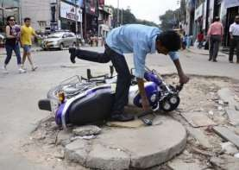
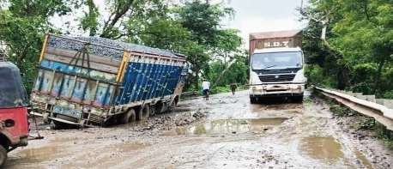
Problem Identification
▶Implementing an intelligent and efficient system for real-time pothole detection on roadways, utilizing computer vision and sensor technologies. The system should accurately identify potholes, assess their severity, and automatically transmit geospatial data, including precise location coordinates, to relevant authorities.The existing pothole detection system faces a critical loophole as it relies solely on user complaints to authorities. The absence of proactive reporting mechanisms results in a delayed identification and resolution of potholes. This solution aims to enhance road safety, reduce vehicle damage, and streamline municipal response to road maintenance by providing timely and actionable information on pothole occurrences

Slide 14
Proposed System
▶ Our roads face a constant battle with potholes, posing safety hazards and costing drivers in repairs. Existing reporting methods often rely on GPS, limiting accessibility and accuracy.
▶In response, we propose a smart pothole detection and reporting system built into a mobile application, empowering anyone to contribute without limitations.
▶ This system leverages the power of machine learning, analyzing footage from the car's front and back cameras to identify potholes in real-time. This is can be done by collecting the images as the dataset by training a machine learning in which it involves the machine learning architetcures like YOLOv5.
▶ And this was integrated to mobile application by using the TensorFlow Mobile or PY Torch lite. For increased range and accuracy, we can even integrate optional sensors like LiDAR or radar.
▶ But what about location ? We are using GPS powered tracking which enhance a better location tracking.GPS isn't always reliable, especially in remote areas. No worries! We've got that covered too! Our system utilizes a combination of cellular network triangulation, WiFi positioning, and visual landmark recognition to pinpoint the pothole's location with impressive precision.

Slide 15
Proposed System
▶ To avoid duplicate reports and clutter, we utilize a smart database like InfluxDB,TimescaleDB.that tracks each pothole's timestamp and status (pending, approved, repaired). This ensures only unique and relevant information reaches the authorities, facilitating faster repairs and resource optimization.
▶ Imagine an intuitive mobile app where you can easily report potholes with photos, descriptions, and severity levels. Our system then displays these reports on an interactive map, keeping everyone informed about the progress.
▶ The benefits: improved road safety, enhanced communication between citizens and authorities, optimized resource allocation, and valuable data-driven insights for infrastructure planning.This is more than just a project; it's a revolution in pothole detection and reporting. By empowering communities, we can pave the way for safer and smoother roads for all.

Slide 16
Design Phase
Design Constraints:
Design constraints are the limitations of a design. These include imposed limitations that you don’t control and limitations that are self-imposed as a way to improve design. There are several types of design constraints and they are as follows
Commercial constraints: In this we consider the basic commercial requirements such as time and budget
Requirements:In the requirements phase we consider the functional requirements of a system and they specify the results of a system.
Non-functional requirements:Requirements that specify intangible elements of a design.
Compliance:Compliance to applicable laws, regulations and standards.

Slide 17
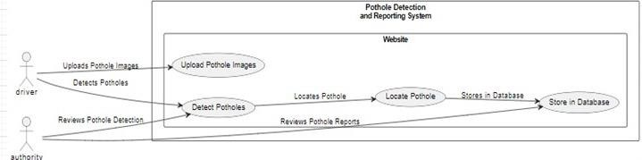
Use case diagram
Use case diagram at its simplest is a representation of a user’s interaction with the system that shows the relationship between the user and the different use cases in which the user is involved.

Slide 18
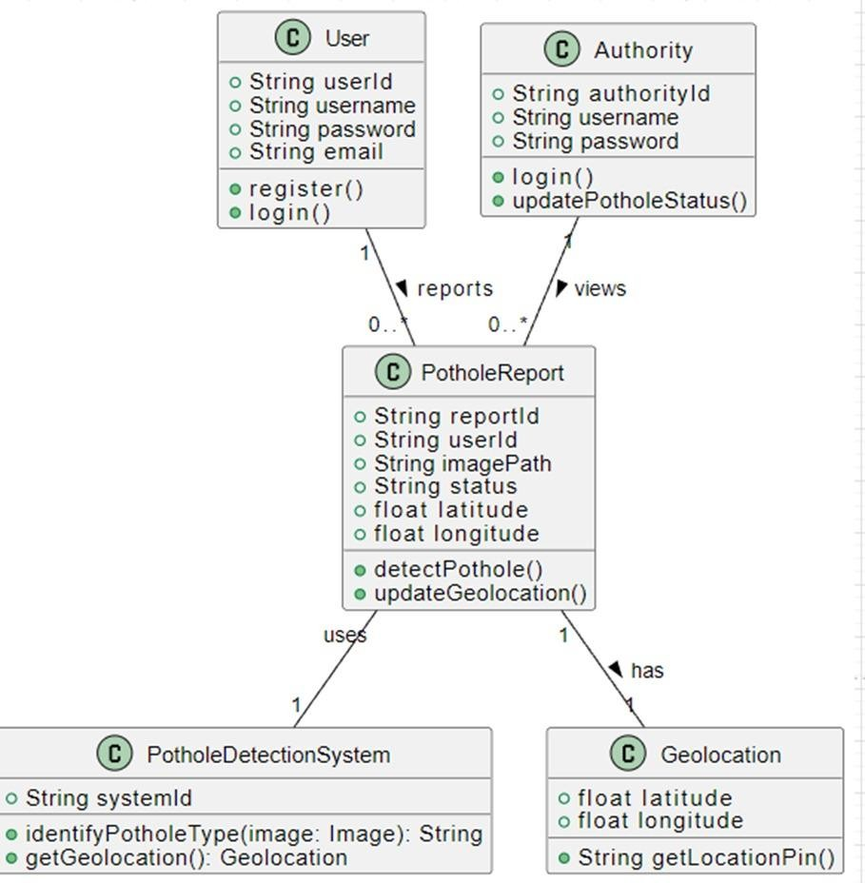
Class diagram
Class diagram in the Unified Modeling Language (UML) is a type of static structure diagram that describes the structure of a system by showing the system's classes, their attributes, operations (or methods), and the relationships among objects.

Slide 19
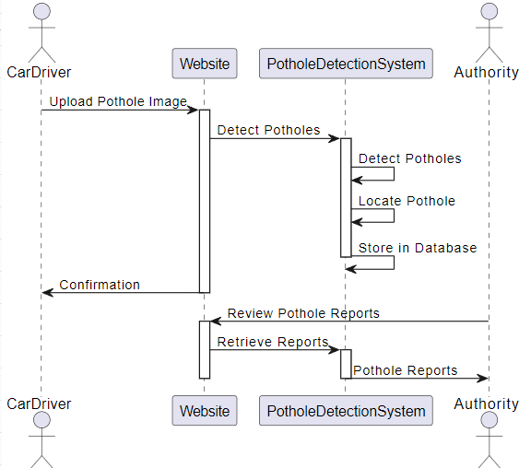
Sequence diagram
A Sequence diagram shows object interactions arranged in time sequence. It depicts the objects and classes involved in the scenario and the sequence of messages exchanged between the objects needed to carry out the functionality of the scenario.

Slide 20
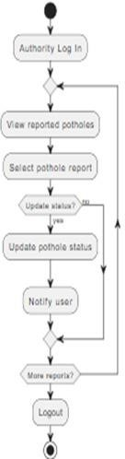
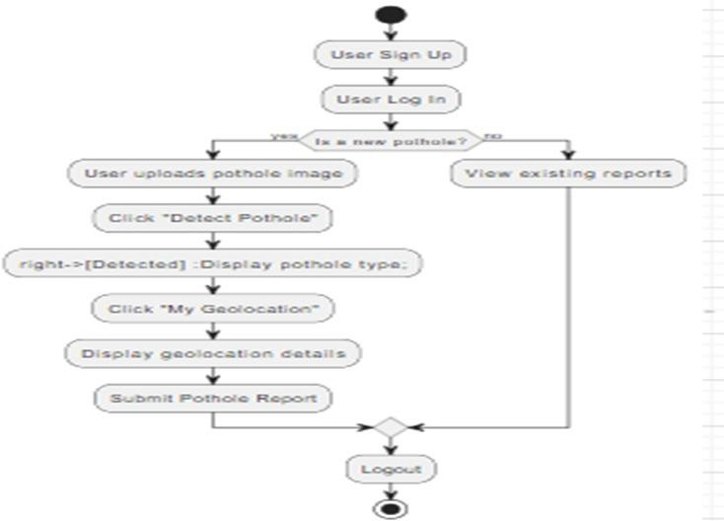
Activity diagram
Activity diagrams are graphical representations of workflows of stepwise activities and actions with support for choice, iteration and concurrency.
AcA

Slide 21
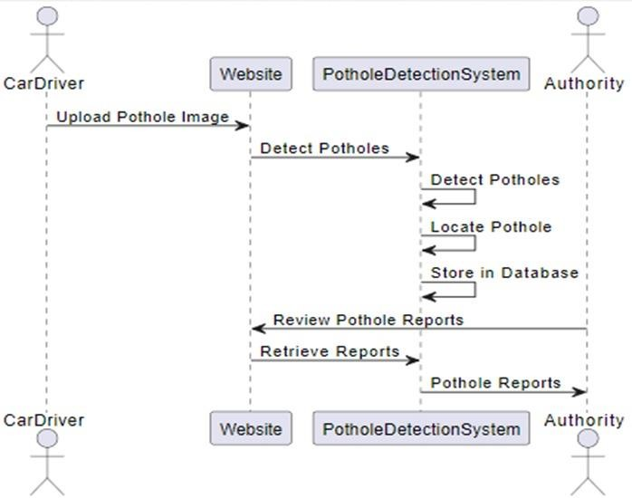
Collaboration diagram
A Collaboration diagram models the interactions between objects or parts in terms of sequenced messages

Slide 22
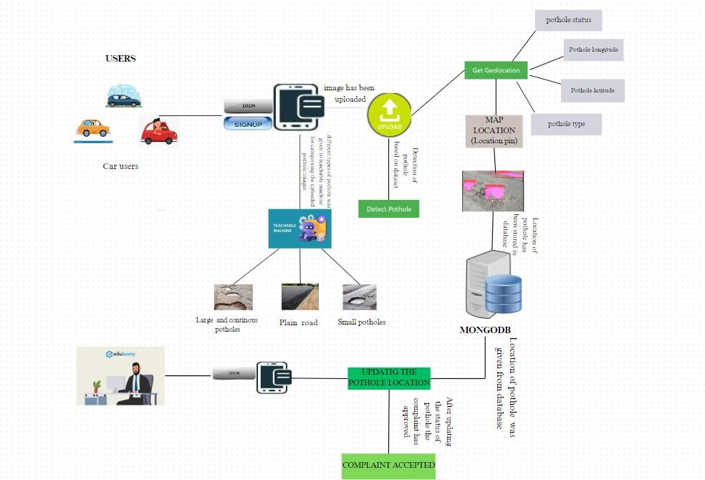
System Architecture
Architectural design is a concept that focuses on components or elements of a structure any changes the client wants to make to the design should be communicated to the architect during this phase.

Slide 23
Algorithms Design
Algorithm for user:
Start.
Open the Pothole Detection Application.
Capture an image of the road surface using the camera feature.
Preprocess the captured image to enhance features and remove noise.
Extract relevant features from the preprocessed image.
Apply a machine learning model to the extracted features to detect potholes.
Classify the detected potholes based on their type or severity.
Store information about the detected potholes, including location and classification.
Notify relevant authorities or users about the detected potholes, if necessary.
View the results of the pothole detection process.
Logout.
Stop.

Slide 24
Algorithm Design
Algorithm for Authority:
Start.
Check reported potholes.
Assess severity and location.
Prioritize based on safety impact.
Assign repair tasks.
Update pothole status.
Coordinate with maintenance teams.
Monitor repair progress.
Inform users about updates.
Review analytics.
Stop.

Slide 25
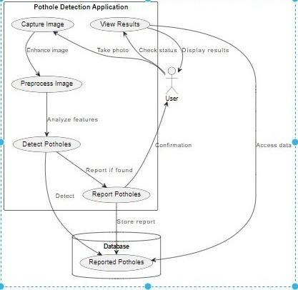
Database Design
Database design is the organization of data according to a database model. The designer determines what data to be stored and how the data elements interrelate.
Dataflow Diagram for user :

Slide 26
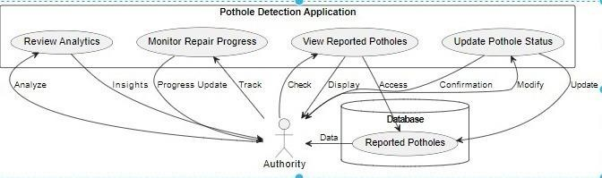
Database Design
Dataflow diagram of Authority:

Slide 27
Coding
The sample coding phase of an application typically involves writing code that implements the design and functionality of the application based on the specifications and requirements gathered during the planning and design phase.
ADASHBOATD.HTML
<!-- templates/index.html -->
<!DOCTYPE html>
<html lang="en">
<head>
<meta charset="UTF-8">
<meta name="viewport" content="width=device-width, initial-scale=1.0">
<title>Pothole Detection</title>
<link rel="stylesheet" type="text/css" href="{{ url_for('static', filename='styles.css') }}">
<link rel="stylesheet" href="https://stackpath.bootstrapcdn.com/bootstrap/4.5.2/css/bootstrap.min.css">
<script src="https://code.jquery.com/jquery-3.5.1.slim.min.js"></script>
<script src="https://cdn.jsdelivr.net/npm/@popperjs/core@2.5.4/dist/umd/popper.min.js"></script>
<script src="https://stackpath.bootstrapcdn.com/bootstrap/4.5.2/js/bootstrap.min.js"></script>
<script>
function getLocation() {
if (navigator.geolocation) {

Slide 28
Coding
navigator.geolocation.getCurrentPosition(sendPosition);
} else {
alert("Geolocation is not supported by this browser.");
}
}
function sendPosition(position) {
var latitude = position.coords.latitude;
var longitude = position.coords.longitude;
// Send latitude to Python server
var xhr = new XMLHttpRequest();
xhr.open("POST", "/receive_location", true);
xhr.setRequestHeader("Content-Type", "application/json");
xhr.onreadystatechange = function () {
if (xhr.readyState === 4 && xhr.status === 200) {
console.log("Location sent successfully");
}
};

Slide 29
Coding
xhr.send(JSON.stringify({latitude: latitude,longitude:longitude}));
}
</script>
<style>
body {
font-family: 'Segoe UI', Tahoma, Geneva, Verdana, sans-serif;
background-color: #2e92cc;
margin: 0;
padding: 0;
/* display: flex; */
justify-content: center;
align-items: center;
height: 100vh;
}
.form {
background-color: #ffffff;
padding: 20px;
border-radius: 8px;
box-shadow: 0 0 20px rgba(0, 0, 0, 0.1);
width: 2000px;
margin-top:100px;
margin-left:100px;
text-align: center;
}

Slide 30
Coding
h2 {
color: #2ea4cc;
}
label {
display: block;
margin: 10px 0;
color: #555;
}
input {
width: calc(100% - 16px);
padding: 8px;
margin-bottom: 16px;
box-sizing: border-box;
border: 1px solid #ccc;
border-radius: 4px;
font-size: 14px;
}

Slide 31
Coding
input[type="submit"] {
background-color: #2e9fcc;
color: white;
cursor: pointer;
transition: background-color 0.3s ease;
}
input[type="submit"]:hover {
background-color: #278eae;
}
p {
color: #777;
margin-top: 10px;
}
a {
color: #2e9dcc;
text-decoration: none;
font-weight: bold;
}

Slide 32
Coding
a:hover {
text-decoration: underline;
}</style>
</head>
<body>
<nav class="navbar navbar-expand-lg navbar-light bg-light">
<a class="navbar-brand" href="/">Pothole Detection</a>
<button class="navbar-toggler" type="button" data-toggle="collapse" data-target="#navbarNav" aria-controls="navbarNav" aria-expanded="false" aria-label="Toggle navigation">
<span class="navbar-toggler-icon"></span>
</button>
<div class="collapse navbar-collapse" id="navbarNav">
<ul class="navbar-nav">
<li class="nav-item active">
<a class="nav-link" href="/adashboard">Home</a>
</li>
<li class="nav-item">
<a class="nav-link" href="/updatepothole">Update Pothole</a>
</li>
<li class="nav-item">
<a class="nav-link" href="/logout">Logout</a>
</li>
</ul>
</div>
</nav>

Slide 33
Coding
<div class="form col-sm-8">
<h2>Complained Potholes</h2>
<table class="table">
<tr>
<th>S.No</th>
<th>Pot Hole latitude</th>
<th>Pot Hole Longitude</th>
<th>Pot Hole Status</th>
<th>Pot Hole Image</th>
<th>Pot Hole Type</th>
<th>Map Location</th>
</tr>
{% for i in range(l) %}
<tr>
<td>{{ i+1 }}</td>
<td>{{ dashboard_data[i][0] }}</td>
<td>{{ dashboard_data[i][1] }}</td>

Slide 34
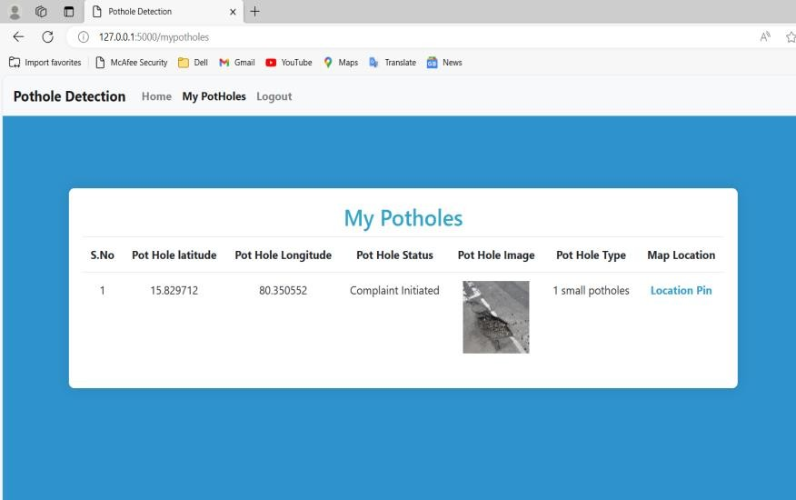
Output Screens
Displays essential information about the pothole, including its geographical coordinates (longitude and latitude) and current status (e.g., complaint initiated). Users can also access a map location, enabling them to pinpoint the pothole's precise location for accurate reporting and resolution

Slide 35
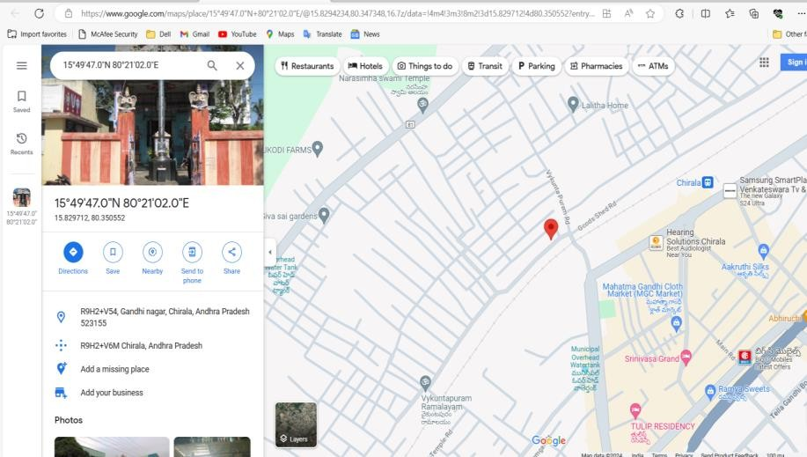
Output Screens
The pothole's location is visually represented on a map interface with a pin marker. This interactive map feature enables users to accurately pinpoint the pothole's location within the system, facilitating efficient reporting and resolution processes.

Slide 36
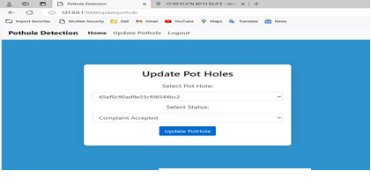
Output Screens
Authorities select potholes and update their status by choosing from predefined options. This interface streamlines the management of reported incidents for efficient resolution.

Slide 37
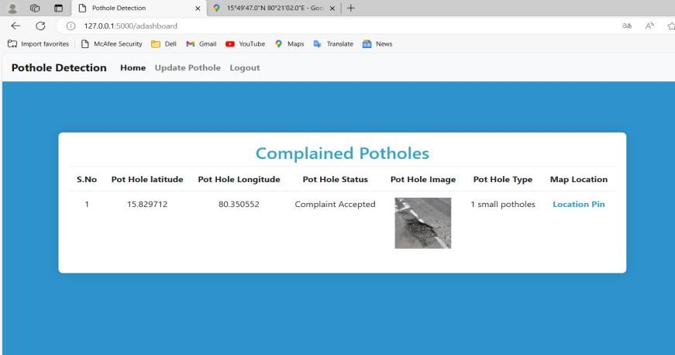
Output Screens
On-screen confirmation of authority's acceptance of the complaint. Users notified of successful processing of their reported pothole.

Slide 38
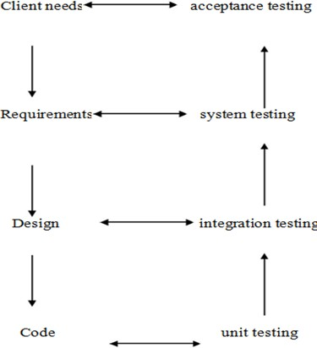
Testing
Testing is the process of trying to discover every conceivable fault or weakness in a work product. It provides a way to check the functionality of components, sub-assemblies, assemblies and or a finished product.
It is the process of exercising software with the intent of ensuring that the Software system meets its requirements and user expectations and does not fail in an unacceptable manner.
There are various types of tests. Each test type addresses a specific testing requirement.
Basic Levels of Testing

Slide 39
Testing
Test case on Verify potholes :
This test case is used to confirm the accuracy of pothole detection from uploaded image.
Test Case 3: .Check user’s registration module. | Priority: Medium
Test Objective: To verify the pothole is detected or not .
Test Description: The verify that pothole are accurately detected from uploaded images .
Test Requirements Verified: Yes
Test Environment:web application .
Test Setup: The server should be in running state and all the required technologies should be installed and the setup of environment should be completed.
Actions: upload an image containing a pothole and click on the detect button | Expected result: pothole is correctly detected
Pass: Yes Conditions pass: Yes Fail: No
Problems or Issues: None
Note: Successfully Processed

Slide 40
Testing
Test case on verify Geolocation:
This test case is used to validate the accurate capturing of pothole locations through geolocation.
Test Case 4: Check the search analysis module. | Priority: High
Test Objective: To verify the data updated in database or not.
Test Description: verify that the system accurately captures pothole locations.
Test Requirements Verified: Yes
Test Environment: Web application .
Test Setup: The server should be in running state and all the required technologies should be installed and the setup of environment should be completed.
Actions: Enable geolocation feature an dupload pothole image. | Expected result: pothole location is accurately captured.
Pass: Yes Conditions pass: Yes Fail: No
Problems or Issues: None
Note: Successfully Processed

Slide 41
Implementation
The following are to be followed during the project:
The system must have a proper Internet connection to run the project.
Open the website. It shows various options there.
If you are a user then choose the user login option in order to login into your account.
If you are new to the site then you can create your new account by choosing the sign in option on the home page.
After logging into the site you can perform the operations by choosing the corresponding option.
If you are the admin, then you can login into the site by clicking admin login on the home page.
Admin can perform the required analysis in his valid account.
After completing the activities to be performed you can logout.

Slide 42
Conclusion
An important development in road upkeep and safety is the Pothole Detection and Reporting System. The system helps to enhance road infrastructure generally by giving consumers a smooth platform to report potholes and authorities the resources they need to remove them quickly.
The process of locating, reporting, and fixing potholes has been effectively expedited by the system's use of machine learning algorithms, geolocation technologies, and user-friendly interfaces.The system has proven useful in promoting citizen-authority communication throughout its implementation, leading to timely and focused responses to reported traffic problems.
Through the use of technology, the system has enabled communities to take an active role in maintaining local road networks, which has eventually made travel safer and more convenient for everyone.

Slide 43
Future Enhancements
In order to further promote road safety and infrastructure maintenance, we have identified a number of areas in which we may improve the Pothole Detection and Reporting System in the future. First, in order to increase accuracy and efficiency even further, we want to improve our pothole identification algorithms. We can guarantee improved pothole detection and quicker reaction times by utilizing cutting- edge machine learning approaches and regularly updating our models with fresh data.
We also intend to incorporate real-time data feeds into the system to give authorities and consumers the most recent information on road conditions. Data on traffic volume, meteorology, and road surface quality could be included in this, enabling more pro-active upkeep and decision-making. Additionally, we want to create a specific mobile application for the system that will allow users to conveniently report potholes from their mobile devices when traveling.
We'll also be concentrating on community engagement in an attempt to boost involvement in pothole reporting initiatives. Our goal is to increase public awareness of the value of road maintenance and provide citizens with the tools they need to actively report road hazards by partnering with local groups and launching outreach programs. Finally, we will strive for a smooth interface with municipal databases and systems, which will improve stakeholder engagement and communication while guaranteeing effective resource allocation for pothole repair.
We are dedicated to constantly enhancing the Pothole Detection and Reporting System and ensuring that everyone travels on safer roads, which is why we are giving priority to these upcoming improvements.

Slide 44
Bibilography
Smith, John. Road Maintenance and Safety: A Practical Approach. Publisher XYZ, 2020.
Brown, Sarah. Introduction to Machine Learning in Python. Publisher ABC, 2019.
Johnson, David. Community Engagement in Infrastructure Projects. Publisher DEF, 2018.
White, Emily. Web Application Development with Python and Flask. Publisher GHI, 2021.
Patel, Rajesh. Geolocation Technologies for Transportation Systems. Publisher JKL, 2017.

